Slide 1
Final Project
Shuo-Yen Chueh

Slide 2
Introduction: Brain computer interface experiment

Slide 3
Behavioral data format

Slide 4
Behavioral data format

Slide 5
Behavioral data format

Slide 6
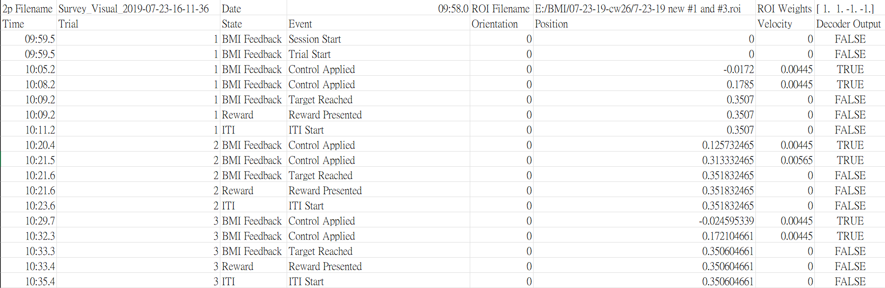
Behavioral data format
Behavioral experiment set up
Trial 1
Random start point
Trial 2

Slide 7
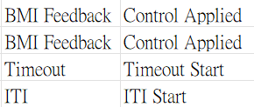
Behavioral data format
Behavioral experiment set up
Trial 1
Random start point
Trial 2
There are also other parameters to tune the behavioral set up, e.g. Impulse, max_velocity, stop & start threshold, random_start_range, ITI length…etc
Failed trial if time out

Slide 8
The purpose of original MATLAB code
Extract the basic information: 1. Total experiment duration 2. Total trials and successful trial count 3. Success rate and reward frequency 4. Average and standard deviation of trial duration
Visualization of trajectory: 1D & 2D version, Trial path length.
Batch file analysis: Output a summarization file.
Ensemble-based group analysis: plot the bar chart of each neuron ensemble giving the statistics results.

Slide 9
Goal
Output the same figures and files regarding the same input CSV file.
List the necessary functions for processing the data frame and write them as def functions.
Have the notation of each def function to ensure modification in the future.

